Slide 1
Computer Brains and Python Functions

Slide 2
Computers are useless tools.
But given a program to run they
become highly specialized and
useful tools.

Slide 3
Computers, Robots and Python
There is a close relationship between computers and robots.
Python can be used to program both.
We are working with a robot but really learning to program computers in general.
Programming a robot is much like “wiring” its brain.
Wiring a brain is much like actually creating a brain.
Programming a robot is giving it a brain. But a brain that only knows how to do one thing.
Remember Homer Simpson.

Slide 4
How do Robots Think?
Imagine a robot that operates a Zamboni machine.
Imagine your own brain on “automatic pilot” when you are mowing the lawn.
Imagine a robot vacuum cleaner that cleans the floor in a room empty of furniture.
. . .

Slide 5
Possible Work Algorithms:
Distance:
M = width of robot
L = outside length of surface area
W = outside width of surface area
D = distance to travel in a straight line
point robot along longest side
D = L
travel in a straight line distance D
while W > 0:
if D == L :
W = W – M; D = W
else:
L = L – M; D = L
turn left 90 degrees
travel in a straight line distance D
each time the machine proceeds
along one side, the length to travel
is reduced by one robot width.

Slide 6
Possible Turning Algorithms:
Timing:
M = time to travel width of robot
L = time to travel outside length of surface area
W = time to travel outside width of surface area
D = time to travel in a straight line
point robot along longest side
D = L
travel in a straight line for time D
while W > 0:
if D == L :
W = W – M; D = W
else:
L = L – M; D = L
turn left 90 degrees
travel in a straight line for time D
NOTE: This algorithm is very
similar to the previous. This is
because there is such a strong
relationship between distance
and time that knowing one often
determines the other.
Californian: How far do you live from New York City?
New Yorker: I live 90 minutes from New York City.
Californian: You tell me how far away it is and I’ll
tell you how long it will take me to get there.

Slide 7
Possible Turning Algorithms:
Cleanliness:
# This algorithm requires a sensor on the left side of the robot to determine
# if the work surface to the left of the robot has been processed
point robot along one side
travel in straight line
while sensor detects unprocessed surface:
turn left
travel in a straight line
NOTE: This algorithm is simpler than the other algorithms
because the robot is more complex (it has a “dirt” sensor).
In general, programs that have a complicated set of variables
are simpler than programs that try to do everything with program
code.

Slide 8
Python Program Structure:
It is common to start every program by calling a function called main().
There is really no difference between main() and any other function. It is just custom that makes a program begin with main().
def main():
<do something> # perhaps a function call
<do something> # perhaps a function call
<do something> # perhaps a function call
. . .
main()‏

Slide 9
Python Program Structure:
every robot program starts
with this.
from myro import *
# import other modules
initialize('com4')‏
# define extra functions you may need
def main():
# do something
. . .
main()‏

Slide 10
Function Calls:
Recall
type() is a function
  Its name is type
  You can pass an argument that can be any expression
  Entering the name, followed by an expression in parentheses is called “calling the function” or a “function call”.
  Function calls “return” a value; in the case of type() the value is a “type” object that prints out as:
>>> type(“32”)
<type ‘string’>
<type ‘type_name’>

Slide 11
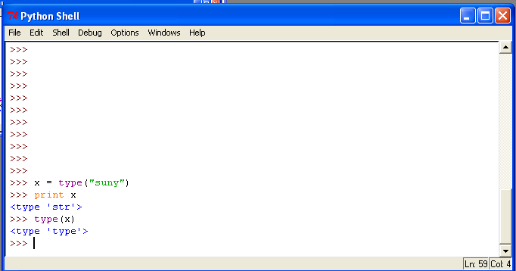
Another Type Example:
The type(type) is a <type ‘type’>

Slide 12
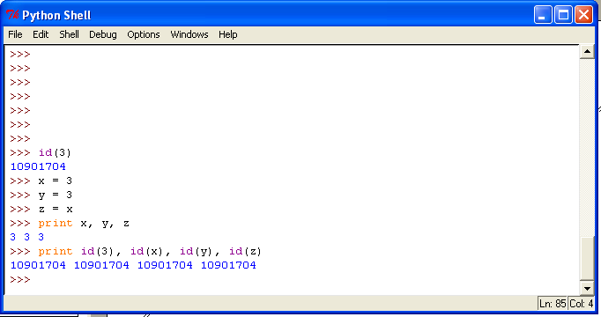
The id() function:
Every object has a unique identifier called its id.
In this example 3, x, y and z are all the same object with the same id.

Slide 13
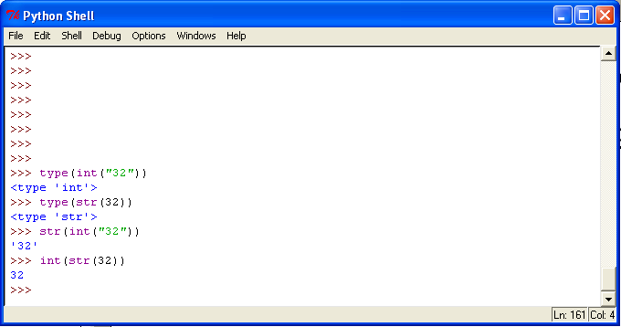
Converting from one Type to Another:
We know 32 is an integer and “32” is a string but
is an integer and
is a string
int(“32”)‏
str(32)‏

Slide 14
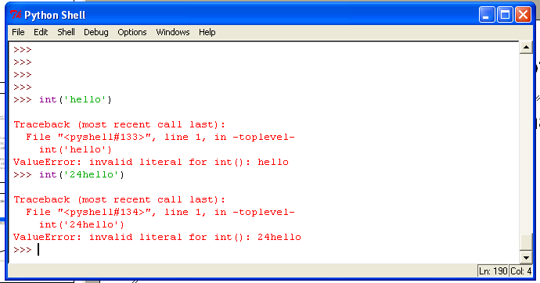
Converting from one Type to Another (cont):
You can’t convert what doesn’t match

Slide 15
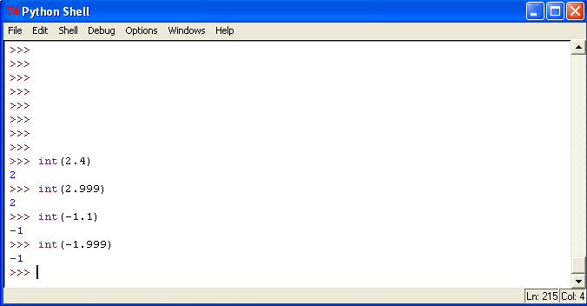
Converting from one Type to Another (cont):
Converting is a way of truncating the decimal part of a floating point number. This is NOT the same as rounding.

Slide 16
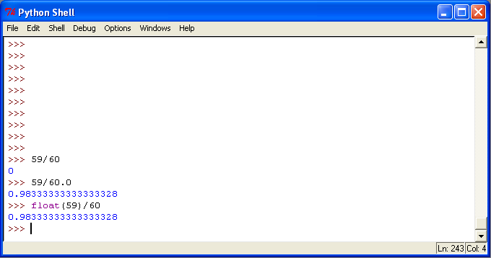
Converting from one Type to Another (cont):
Automatic type conversion is called type coercion.
integer division
floating point division forced on
Python by the real operand;
called type coercion.

Slide 17
Modules:
A module is a file containing many definitions.
It usually has the file extension .py.
myro is a module.
To use the contents of a module you must “import” it.
“Dot Notation” means naming things with both module and function name
Dot notation is much like the naming conventions for Internet names
import myro # must use “dot notation” to use functions
from myro import * # don’t need the “dot notation” to use functions
module name.function name
www.newpaltz.edu
www.vassar.edu

Slide 18
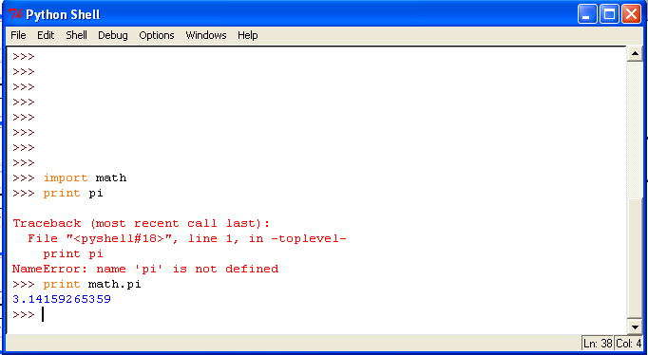
Math Functions:
Math functions are found in the module called math.
You can use them if you “import math”.
dot notation
module name.function name

Slide 19
Math Module contents:
In addition to pi, the math module contains trig functions like sine (sin()) and cosine (cos()), absolute value (abs()), square root (sqrt()) as well as various log and exponentiation functions.

Slide 20
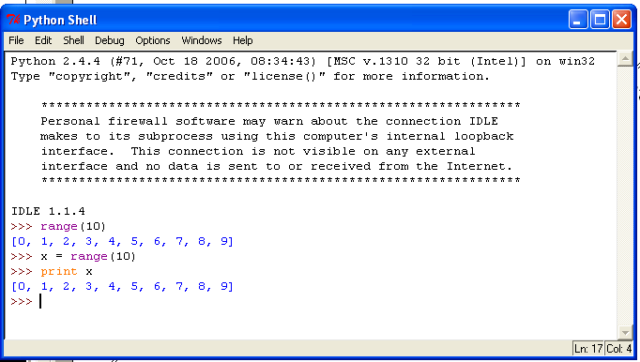
Other useful Functions:
Python has a useful function called range().

Slide 21
Versions and Uses of range([start],stop,[step]):
range(10) # returns [0, 1, 2, 3, 4, 5, 6, 7, 8, 9]
range(4,10) # returns [4, 5, 6, 7, 8, 9]
range(5,7,0.3) # returns [5, 5.3, 5.6, 5.9, 6.2, 6.5, 6.8]
range(5,-4,-2) # returns [5, 3, 1, -1, -3]
If L is a list/sequence object then
L.slice([start],stop,[step])‏
returns the elements of L with indexes
returned by range([start],stop,[step])‏
Alternative notation:
L[start:stop:step]
http://docs.python.org/library/functions.html

Slide 22
Slicing Lists and Other Things:
L[negative] indexes the list from the end starting at -1.
L[1:3] is a new list consisting of [L[1], L[2], L[3]]. With the third argument missing, the default value for step is 1.
L[1:] is a new list consisting if [L[1], ... ]
L[:] is the entire list
L[2:-1] is the new sublist [L[2], ..., L[-2]] and does not include the last element
L[3:3] is an empty sublist just before L[3]. We can assign to it:
L[3:3] = [a,b,c] inserts a new sublist just before L[3]
http://www.diveintopython.org/native_data_types/lists.html

Slide 23
More List Stuff
starting at the second last
element in the list and stepping
down by 2, stopping before
L[-7] == L[0]
L = [1,2,3,4,5,6,7]
M = L[-2:-7:-2]
print M
N = L[1:-1:2]
print N
[6, 4, 2]
[2, 4, 6]
Observation:
If len(L) == n and -n <= a <= -1
then L[a] is really L[n+a]
Exercise: Write a python function that returns a list
in reverse order.
def rev(L):
stop = -1*len(L)-1
return L[-1:stop:-1]

Slide 24
Defining Functions:
General Syntax:
A function is a named sequence of statements that do something desired.
You can’t use any of the 28 key words as function names.
You can put the function definitions anywhere you want but you must define a function before you use it.
Until now, most of the functions we have used have been defined for us in modules like myro.
def function_name (list of parameters):
statements # indented

Slide 25
More Functions:
Defining newline() gives a “mneumonic” name for an activity. print does the same thing but is less intuitive.
print is a key word, not a function, so doesn’t need ().
A programmer might call newline() by a different name, nl().
def newline():
print
def nl():
print

Slide 26
Functions of functions:
You can use functions to define others:
Alternative definition:
def threeLines():
nl()‏
nl()‏
nl()‏
This is called a for-loop. A variable, i,
takes on every value in range(3), which
we know to be the list [1,2,3].
We don’t actually use the value of i but
we could, inside the for-loop block.
def threeLines():
for i in range(3):
nl()‏

Slide 27
For Loop:
General Format
For loops are used when you want to do the same thing over an over again and you know how many times in advance.
for <variable> in <sequence>:
do something
do something
. . .

Slide 28
Exercise:
Write a function, using a for loop, that will call newline() n times, where n is the function parameter.
def newLines(n):
for i in range(n)‏
nl()‏

Slide 29
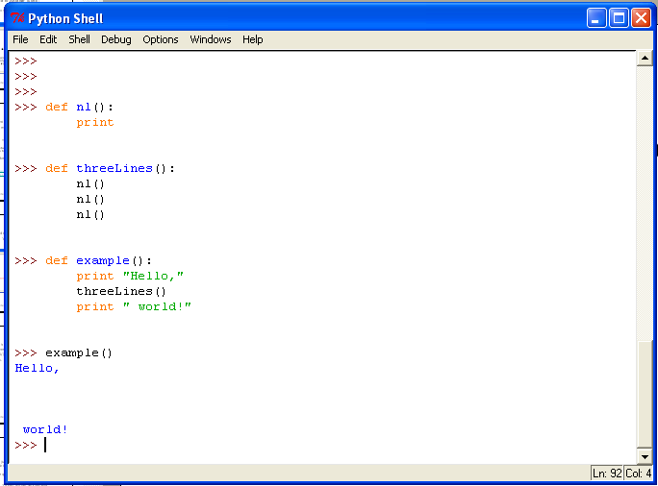

Slide 30
Exercise:
Write a function that prints out 9 lines.
Now write a function that prints out 27 lines.
def nineLines():
threeLines()‏
threeLines()‏
threeLines()‏
def twentySevenLines():
nineLines()‏
nineLines()‏
nineLines()‏

Slide 31
Why write functions?
Writing a function gives you an opportunity to name a group of code and make use of it by name instead of writing out all the code again.
Picking a good name for code is not always easy.
If you can’t name a thing, perhaps you don’t know what it is so you shouldn’t write or use it.
Normally you think of a name first and then figure out how the function should be written (but not always).
The name of a function should be indicative of what it does.
def twentySevenLines():
nineLines()‏
threeLines()‏
nineLines()‏
bad idea

Slide 32
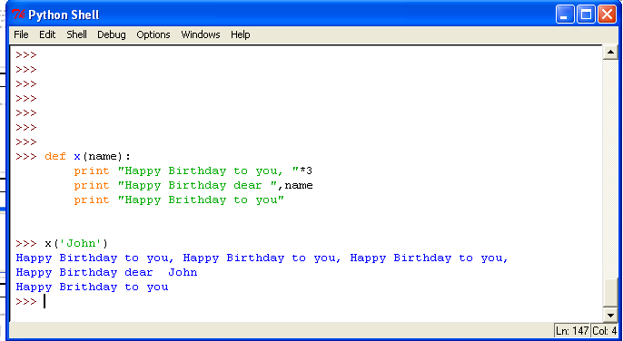
Name this function:

Slide 33
Execution flow:
# happy_birthday_2.py
from myro import *
def getName():
return ask("Whose birthday is it? ")‏
def happyBirthday(name):
print "Happy Birthday to you,"
print "Happy Birthday to you,"
print "Happy Birthday to you,"
print "Happy Birthday dear", name+’,’
print "Happy Birthday to you."
def getAgeOf(name):
return ask("How old are you, "+name)‏
# same program with function calls
def main():
bd_name = getName()‏
happyBirthday(bd_name)‏
age = getAgeOf(bd_name)‏
print name, "is", age, "years old.“
main()‏
#happy_birthday_1.py
from myro import *
name = ask("Whose birthday is it? ")‏
print "Happy Birthday to you,"
print "Happy Birthday to you,"
print "Happy Birthday to you,"
print "Happy Birthday dear", name+’,’
print "Happy Birthday to you."
age = ask("How old are you, "+name)‏
print name, "is", age, "years old."
NOTE: These programs have the
same execution flow but one is easier
to read than the other.

Slide 34
Parameters and Arguments:
In the previous example name is a parameter and bd_name is an argument.
You pass arguments to parameters
parameter, part of definition
def happyBirthday(name):
print "Happy Birthday to you,"
print "Happy Birthday to you,"
print "Happy Birthday to you,"
print "Happy Birthday dear", name+’,’
print "Happy Birthday to you."
. . .
happyBirthday(bd_name)‏
argument, part of function call

Slide 35
Parameters and Arguments (cont):
Imagine a bakery that bakes birthday cakes and on the top of each cake they write
How much more useful is such a cake than one that says
Parameters are used when we write the function and arguments are used when we use the function.
Why? Because we don’t know when we write the function precisely what arguments it will use when we use the function.
Happy Birthday
To
Happy Birthday
To
Hugo

Slide 36
Parameters and Arguments (cont):
That space on the top of the cake when the name will go is just like the parameter name in the definition of a function. It is a place where we can “plug in” an argument value when we want to use the function.
For that reason, function parameters are often called place holders.
The name of the argument can be anything. You can write anyone’s name on a blank birthday cake.

Slide 37
Exercise:
Think of other situations where we use “place holders” in our daily lives.
  Order a Pizza
  Shopping List
  Wedding Vows

Slide 38
Parameters:
A parameter can only be used inside the function definition where it is mentioned as a parameter.
If two functions
  x(name) and y(name) have the same parameter this is just a coincidence.
def x(name):
. . .
def y(name):
. . .

Slide 39
Local Variables:
Inside a function definition you can use a variable that is not a parameter. This is called a local variable.
“Local” because it can only be used inside the function definition.
newName can only be used inside getName().
We say that the definition of getName() is the scope of newName.
def getName():
newName = ask("Whose birthday is it? ")‏
return newName

Slide 40
Variable Scope
Variables defined or used for the first time outside any function have scope from that point in the file until the end of the file but not inside any function.
Variables defined or used for the first time inside some function have scope from that point in the file until the end of the function definition.
Variables defined inside the IDLE interface are useable until you close the IDLE window.
A variable can be used as long as it is in scope.

Slide 41
Using Variables Globally:
A variable defined outside any function can be referred to inside a function if it is declared as global inside that function.
x = 1
def a():
global x
y = x + 2
return y
print a()‏
3

Slide 42
Misuse of Variables:
x = 1
def a():
x = 4
return x
print a(), x
4 1
x = 1
def a():
y = x + 2
return y
print a()‏
local variable, x
UnboundLocalError

Slide 43
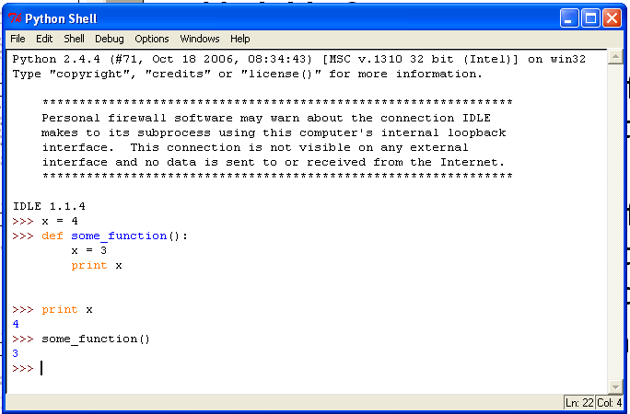
Two variables called x:
scope of x is the entire shell
scope of this x is inside the
function called some_function()
and its value is used only if we
call the function

Slide 44
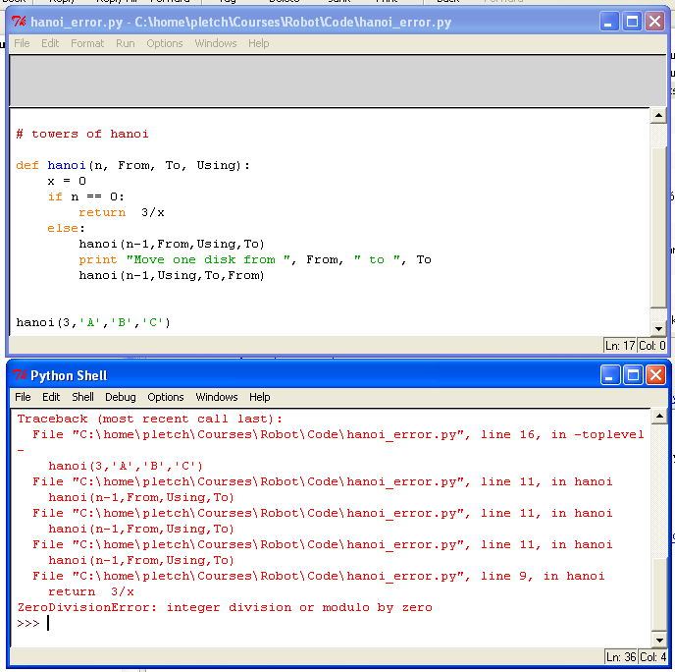
The Stack:
error that shows up only when
n is 0

Slide 45
The Stack
hanoi(3, ‘A’, ‘B’, ‘C’):
x = 0
if n == 0:
return 3/x
else:
hanoi(2,’A’,’C’,’B’)‏
print "Move one disk from ", ‘A’, " to ", ‘B’
hanoi(2,’C’,’A’,’B’)‏
code execution reaches here
and calls hanoi() again.
hanoi(2, ‘A’, ‘C’, ‘B’):
x = 0
if n == 0:
return 3/x
else:
hanoi(1,’A’,’B’,’C’)‏
print "Move one disk from ", ‘A’, " to ", ‘C’
hanoi(1,’B’,’C’,’A’)‏
code execution reaches here
and calls hanoi() again.
hanoi(1, ‘A’, ‘B’, ‘C’):
x = 0
if n == 0:
return 3/x
else:
hanoi(0,’A’,’C’,’B’)‏
print "Move one disk from ", ‘A’, " to ", ‘B’
hanoi(0,’C’,’A’,’B’)‏
code execution reaches here
and calls hanoi() again.
hanoi(0, ‘A’, ‘C’, ‘B’):
x = 0
if n == 0:
return 3/x
else:
hanoi(-1,’A’,’C’,’B’)‏
print "Move one disk from ", ‘A’, " to ", ‘C’
hanoi(-1,’C’,’A’,’B’)‏
code reaches here
and fails

